Slide 1
Introduction to Computational Thermodynamics
Section 3.4
The Isothermal Flash Problem

Slide 2
Introduction
A flash algorithm answers the question: “How many phases will a fluid split into, and what is the composition of each phase”
We use these calculations all across chemical engineering, particularly in separation processes
Examples where these are used include
Modelling flash drums, distillation columns, and liquid-liquid extraction
Simulating petroleum reservoirs and other complex liquid flow

Slide 3
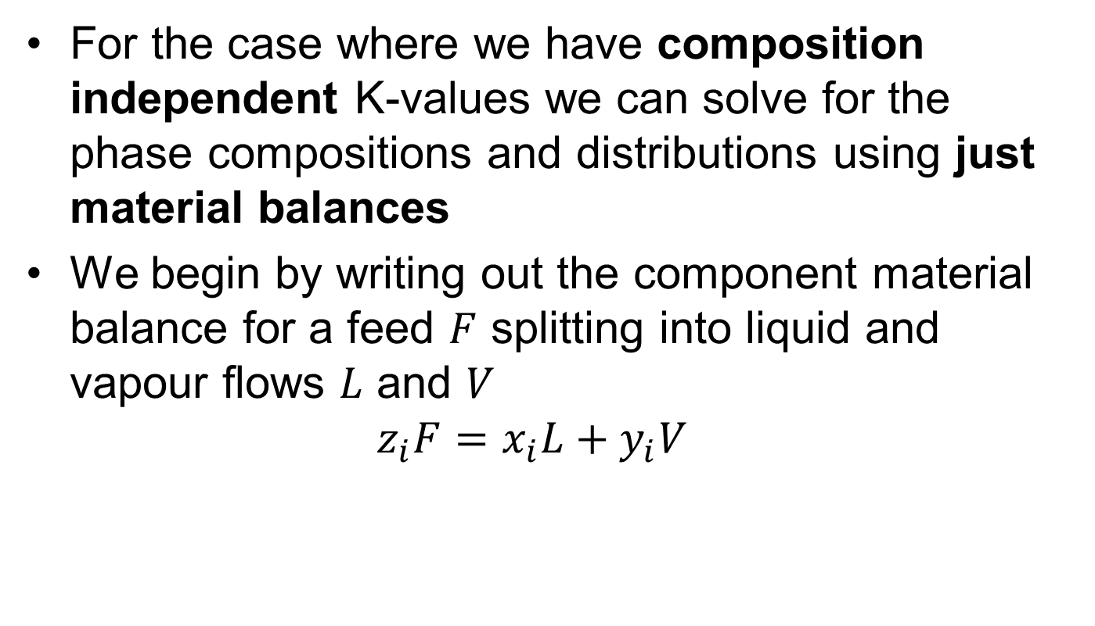
The Rachford-Rice equation
For the case where we have composition independent K-values we can solve for the phase compositions and distributions using just material balances
We begin by writing out the component material balance for a feed $F$ splitting into liquid and vapour flows $L$ and $V$ $z_{i}F=x_{i}L+y_{i}V$

Slide 4
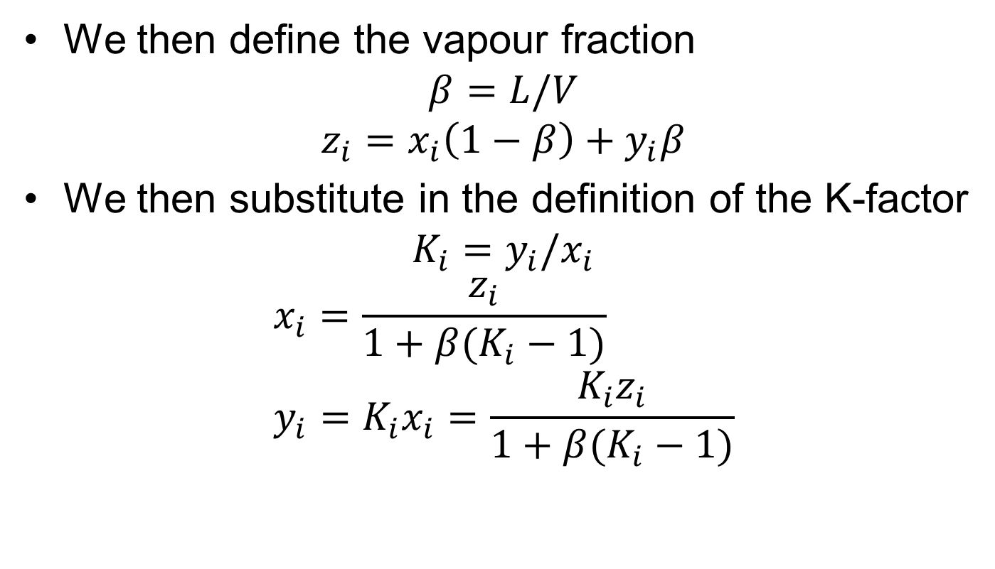
The Rachford-Rice equation
We then define the vapour fraction $β=L/V$
$$z_{i}=x_{i}\left(1−β\right)+y_{i}β$$
We then substitute in the definition of the K-factor $K_{i}=y_{i}/x_{i}$
$$x_{i}=\frac{z_{i}}{1+β(K_{i}−1)} \\ y_{i}=K_{i}x_{i}=\frac{K_{i}z_{i}}{1+β(K_{i}−1)}$$

Slide 5
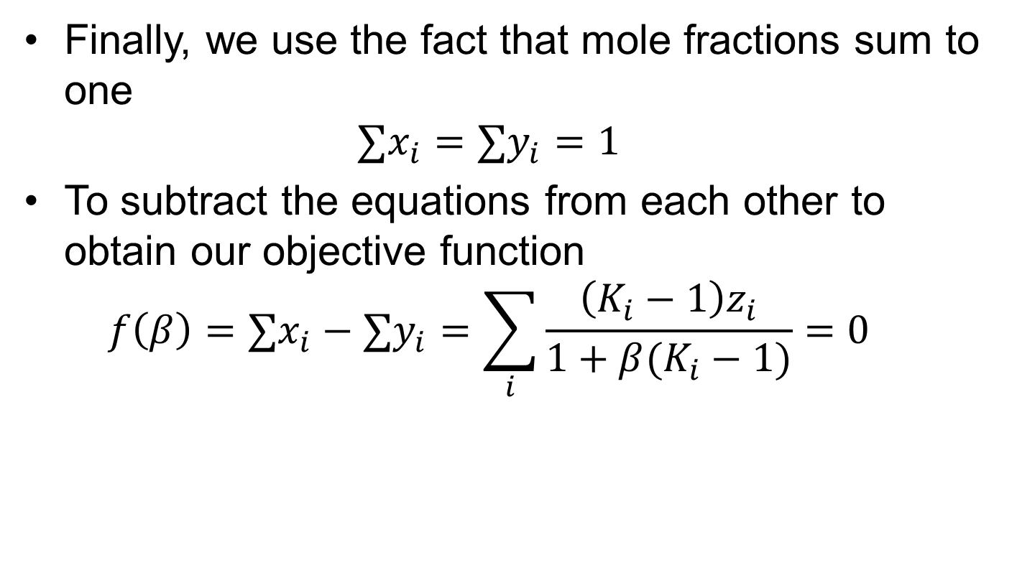
The Rachford-Rice equation
Finally, we use the fact that mole fractions sum to one $∑x_{i}=∑y_{i}=1$
To subtract the equations from each other to obtain our objective function $f\left(β\right)=∑x_{i}−∑y_{i}=\sum_{i}{\frac{\left(K_{i}−1\right)z_{i}}{1+β(K_{i}−1)}=0}$

Slide 6
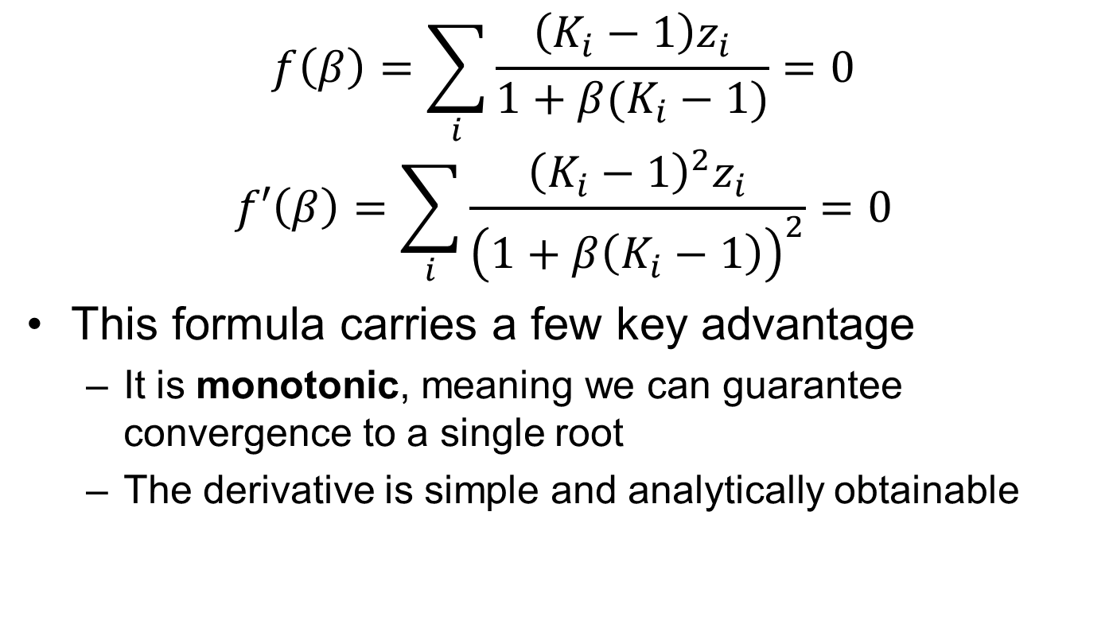
The Rachford-Rice equation
$$f\left(β\right)=\sum_{i}{\frac{\left(K_{i}−1\right)z_{i}}{1+β(K_{i}−1)}=0}$$
$$f′\left(β\right)=\sum_{i}{\frac{{\left(K_{i}−1\right)}^{2}z_{i}}{{\left(1+β\left(K_{i}−1\right)\right)}^{2}}=0}$$
This formula carries a few key advantage
It is monotonic, meaning we can guarantee convergence to a single root
The derivative is simple and analytically obtainable

Slide 7
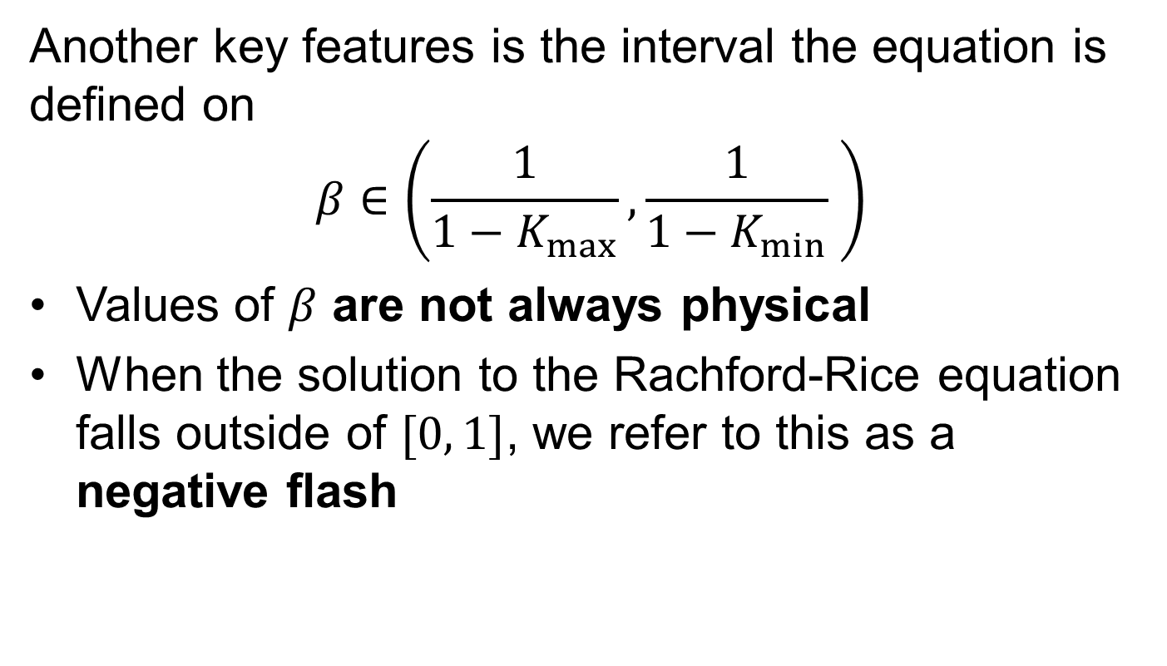
The Rachford-Rice equation
Another key features is the interval the equation is defined on
$$β∈\left(\frac{1}{1−K_{max}},\frac{1}{1−K_{min}} \right)$$
Values of $β$ are not always physical
When the solution to the Rachford-Rice equation falls outside of $[0, 1]$, we refer to this as a negative flash

Slide 8
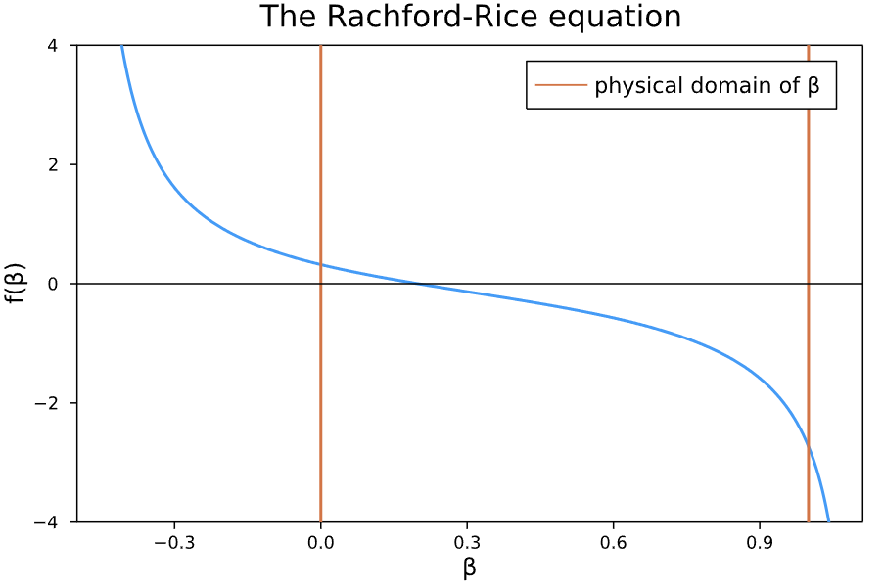
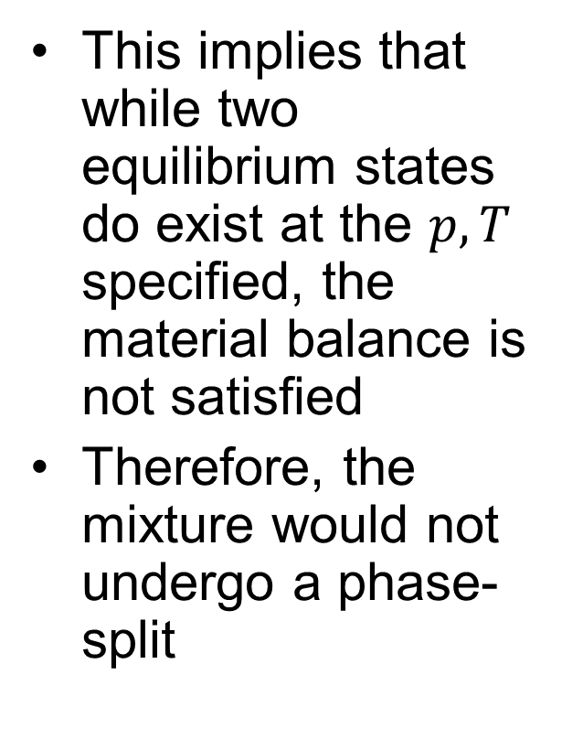
The Rachford-Rice equation
This implies that while two equilibrium states do exist at the $p, T$ specified, the material balance is not satisfied
Therefore, the mixture would not undergo a phase-split

Slide 9

The Rachford-Rice equation
Once the Rachford-Rice equation has been solved for $β$, we can use the original material balances to obtain $x$ and $y$

Slide 10
RR Implementation
We will use Newton’s method to solve this
However – there is an issue we have not dealt with previously: How do we stop our solver stepping outside of the valid solution region?
Luckily, the answer is not too complicated.

Slide 11
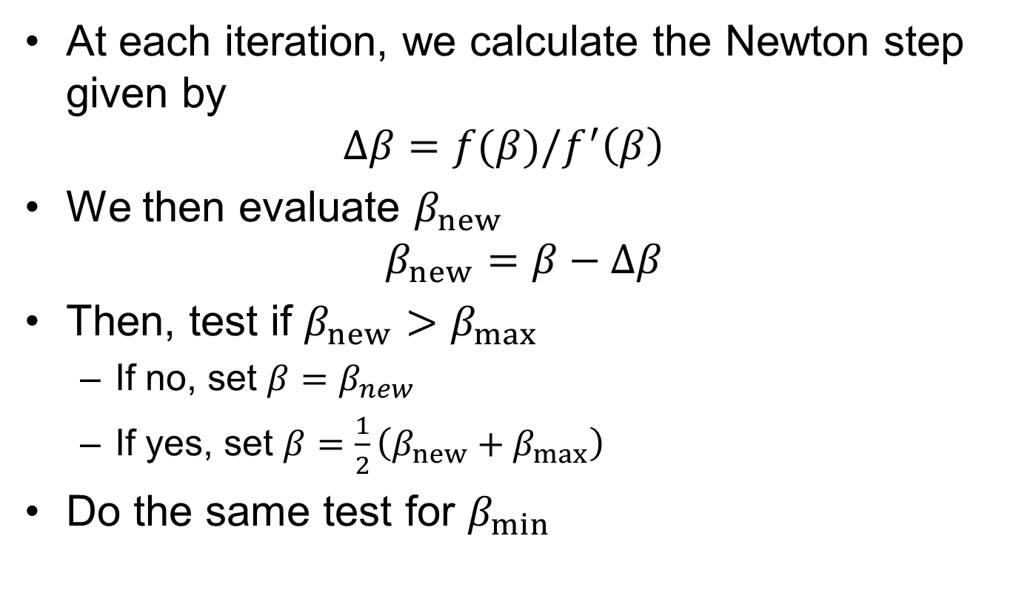
RR Implementation
At each iteration, we calculate the Newton step given by $Δβ=f(β)/f^{′}\left(β\right)$
We then evaluate $β_{new}$ $β_{new}=β−Δβ$
Then, test if $β_{new}>β_{max}$
If no, set $β=β_{new}$
If yes, set $β=\frac{1}{2}\left(β_{new}+β_{max}\right)$
Do the same test for $β_{min}$

Slide 12

Task: Implement the solver
Now – it’s your turn. Switch to the notebook and look at the $solve_β$ routine
It’s your job to finish this routine, there is guidance within the text above as well as comments within the code
There are also three hints below should you want
Split out into individual rooms & work on your solver

Slide 13
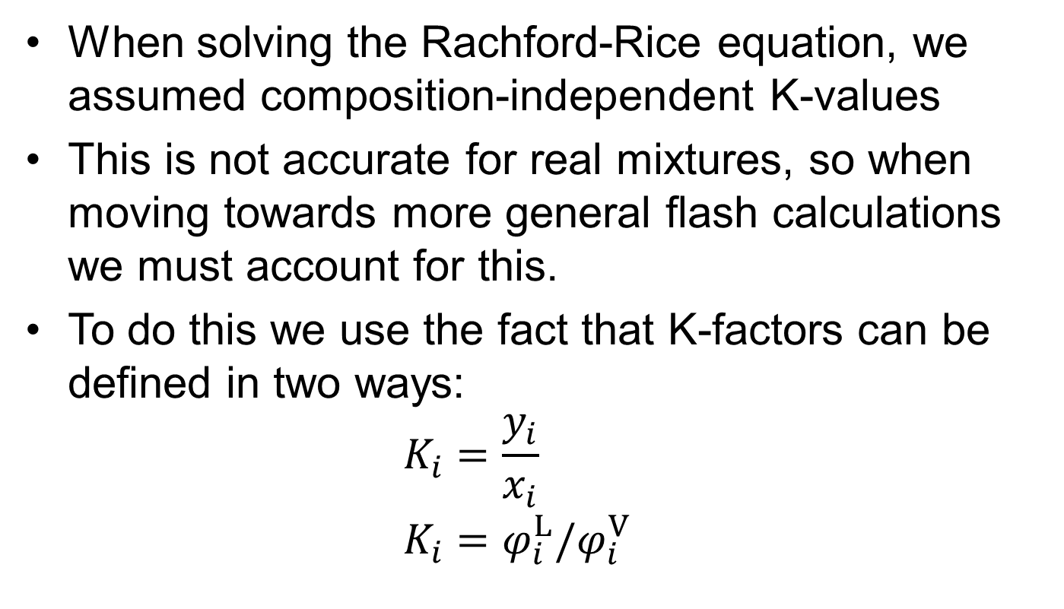
The Isothermal Flash
When solving the Rachford-Rice equation, we assumed composition-independent K-values
This is not accurate for real mixtures, so when moving towards more general flash calculations we must account for this.
To do this we use the fact that K-factors can be defined in two ways: $K_{i}=\frac{y_{i}}{x_{i}}$ $K_{i}=φ_{i}^{L}/φ_{i}^{V}$

Slide 14
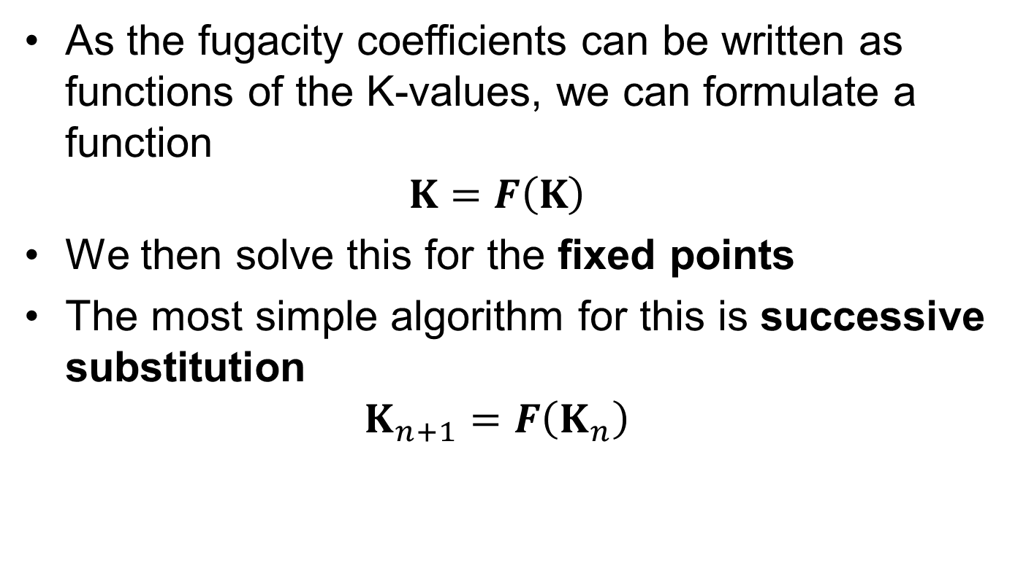
The Isothermal Flash
As the fugacity coefficients can be written as functions of the K-values, we can formulate a function $K=F\left(K\right)$
We then solve this for the fixed points
The most simple algorithm for this is successive substitution $K_{n+1}=F\left(K_{n}\right)$

Slide 15
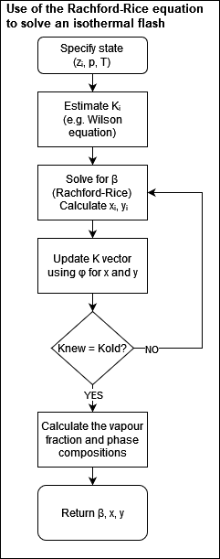
The Isothermal Flash
The isothermal flash is then split into three stages
Initial guesses – the Wilson equation
Begin loop
Solve the Rachford-Rice equation
Update K-factors
Check for convergence
Calculate final vapour fractions and phase compositions

Slide 16
Accelerated Successive Substitution
The first modification typically applied is acceleration
Accelerated successive substitution methods rely on using information about previous iterations to estimate
This information is used to extrapolate successive steps
Prominent method include eigenvalue extrapolation and dominant eigenvalue method. We use Anderson Acceleration

Slide 17
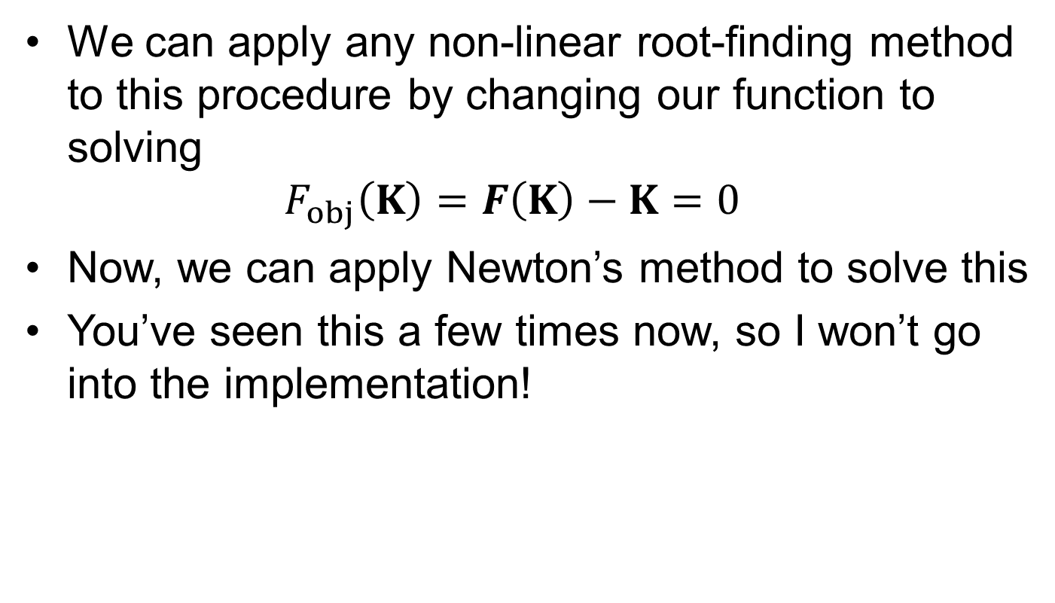
Newton’s Method
We can apply any non-linear root-finding method to this procedure by changing our function to solving $F_{obj}\left(K\right)=F\left(K\right)−K=0$
Now, we can apply Newton’s method to solve this
You’ve seen this a few times now, so I won’t go into the implementation!

Slide 18
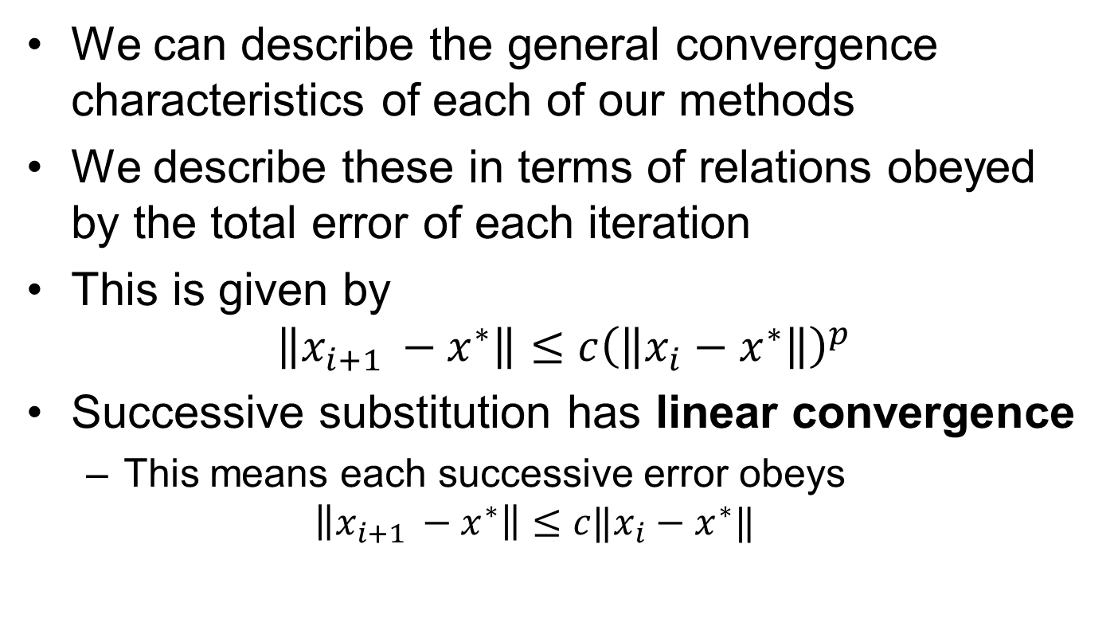
Convergence Characteristics
We can describe the general convergence characteristics of each of our methods
We describe these in terms of relations obeyed by the total error of each iteration
This is given by $\left\|x_{i+1 }−x^{∗}\right\|≤c{\left(\left\|x_{i}−x^{∗}\right\|\right)}^{p}$
Successive substitution has linear convergence
This means each successive error obeys $\left\|x_{i+1 }−x^{∗}\right\|≤c‖x_{i}−x^{∗}‖$

Slide 19
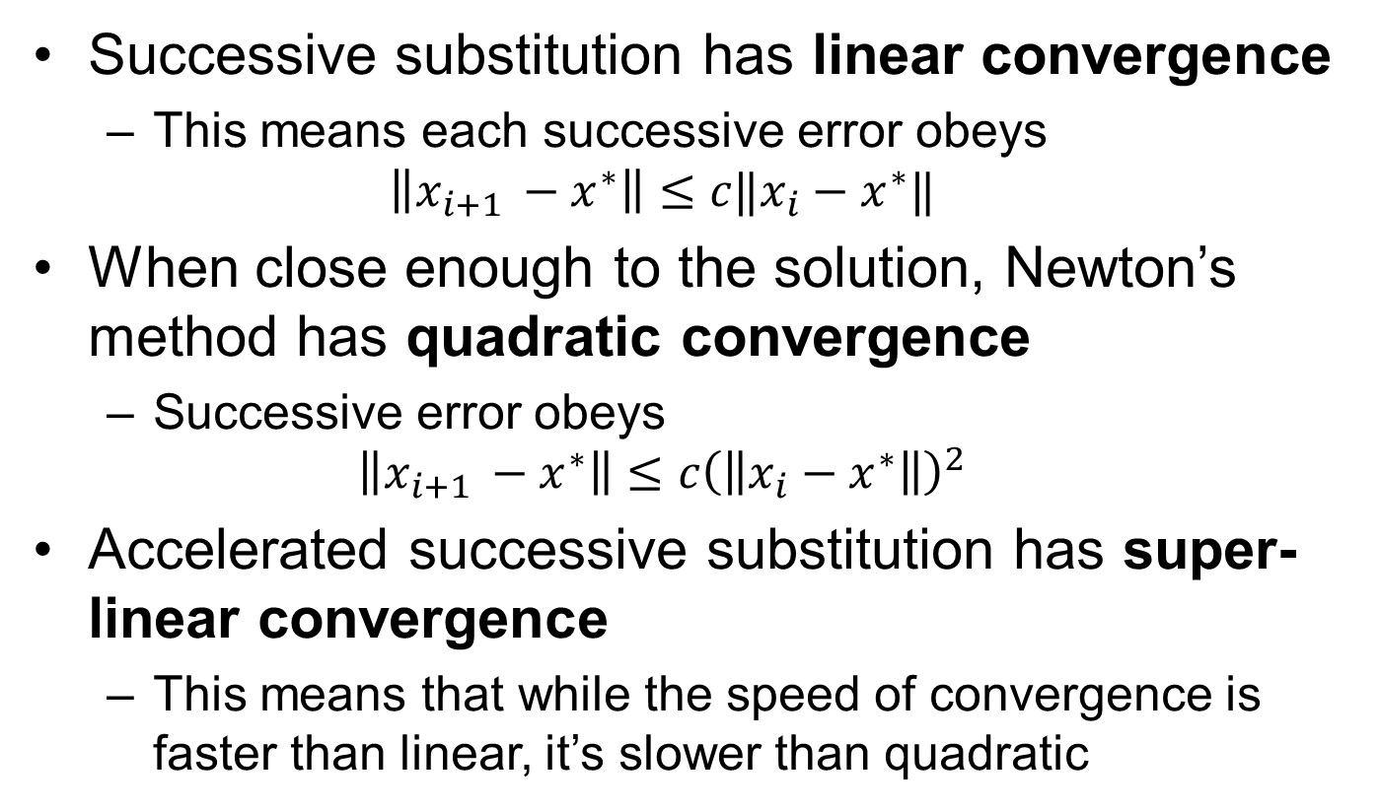
Convergence Characteristics
Successive substitution has linear convergence
This means each successive error obeys $\left\|x_{i+1 }−x^{∗}\right\|≤c‖x_{i}−x^{∗}‖$
When close enough to the solution, Newton’s method has quadratic convergence
Successive error obeys $\left\|x_{i+1 }−x^{∗}\right\|≤c{\left(\left\|x_{i}−x^{∗}\right\|\right)}^{2}$
Accelerated successive substitution has super-linear convergence
This means that while the speed of convergence is faster than linear, it’s slower than quadratic

Slide 20
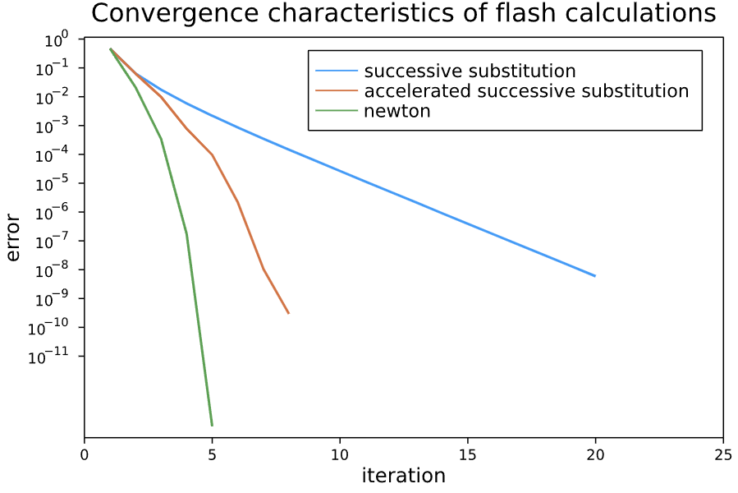
Convergence Characteristics
When using Newton’s algorithm, our algorithm appears to converge far faster. However…

Slide 21
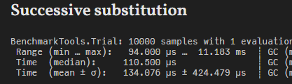
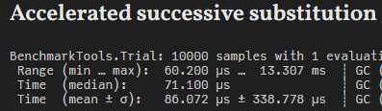
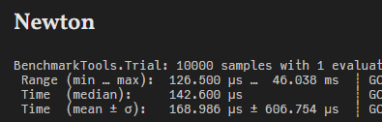
Benchmarks
The error-iteration graph showed the Newton method converged in the least iterations
But, in our benchmarks Newton’s method is actually the slowest!

Slide 22
Method Selection
This happens because of the increased complexity of Newton’s method
Requiring both calculating and inverting the Jacobian is expensive!
This is not to say Newton’s method isn’t ideal, more that it is not always worth the additional cost. You need to consider method choice within the context of your problem

Slide 23
Method Selection
Because of the issues we’ve just discussed, Michelsen proposes a combination method
In this method, 10 iterations of accelerated successive substitution are taken
If convergence has not been achieved, then the solver moves to Newton’s method
This takes advantage of the very quick successive substitution iterations when far from the critical point, but for situations where the problem is difficult, this proves advantageous

Slide 24
Key Points
The Rachford-Rice equation solves for the phase distribution for composition-independent K-values
By wrapping this in an outer-loop updating the K-values with each iteration, we obtain a flash algorithm for real fluids
Although Newton’s method converges in less iterations, it is not always faster than simpler methods

